Slide 1
Introduction to predictive modelling, Applications, Python packages, R packages & Anaconda Navigator Installation
Session 1

Slide 2
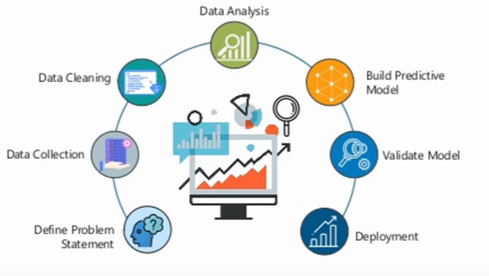
What is Predictive Analytics
Analytics that help you forecast future performance and results.

Slide 3
Data Analytics
Data analytics (DA) is the scientific process of transforming data into insights for making better decisions.

Slide 4
Data Analysis
Data Analysis is the process of inspecting, cleaning, transforming, and modeling data with the objective of discovering useful information, arriving at conclusions, and supporting the decision making process is called Data Analysis.

Slide 5
What is the difference between Data Analysis and Data Analytics
Data Analytics | Data analysis
Form: Data Analytics is general form of analytics which is used in business to make decisions from data which are data driven | Form: Data Analysis is a specialized form of data analytics used in business to analyse data and take some insights of it.
Structure: Data Analytics consist of data collection and inspect in general and it has one or more usage | Structure: Data analysis consist of defining a data investigation, cleaning, transforming the data to give a meaningful outcome.
Tools: There are many analytics tools in a market but mainly R, Tableau Public, Python, SAS, Apache Spark, Excel are used | For analyse the data Open Refine, KNIME, RapidMiner, Google Fusion Tables, Tableau Public, NodeXL, WolframAlpha tools are used
Sequence: Data analytics lifecycle consist of business case evaluation, data identification, data acquisition & filtering, Data Extraction, Data validation & Cleansing, Data Aggregation& Representation, Data Analysis, Data Visualization, Utilization of Analysis Results. | Sequence followed in data analysis are data gathering, data scrubbing, analysis of data and interpret the data precisely so that you can understand what your data want to say.
Usage: It is used to find masked patterns, anonymous correlations, customer preferences, market trends and other necessary information that can help to make more notify decisions for business purpose | Data analysis can be used in various ways like one can perform analysis like descriptive analysis, exploratory analysis, inferential analysis, predictive analysis and take useful insights from the data
Example: Let say you have lgb customer purchase related data of past 1 year, now one has to find that what are customers next possible purchases, you will use data analytics for that. | Example: Suppose you have lgb customer purchase related data of past 1 year and you are try to find what happened so far that means in data analysis we look into past.

Slide 6
Why analytics is important?
Determining credit risk
Developing new medicines
Finding more efficient ways to deliver products and services
Preventing fraud
Uncovering cyber threats
Retaining the most valuable customers

Slide 7
Classification of Data analytics
Descriptive Analytics – What happened? (eg:reports, data dashboard)
Diagnostic Analytics – Why did it happen? (eg : Correlations, Data mining)
Predictive Analytics – What will happen?
Historical data → Predictive Algorithm → Model
New data →Model → Predictions
Prescriptive Analytics – How can we make it happen? (eg: simulation, decision analysis)

Slide 8
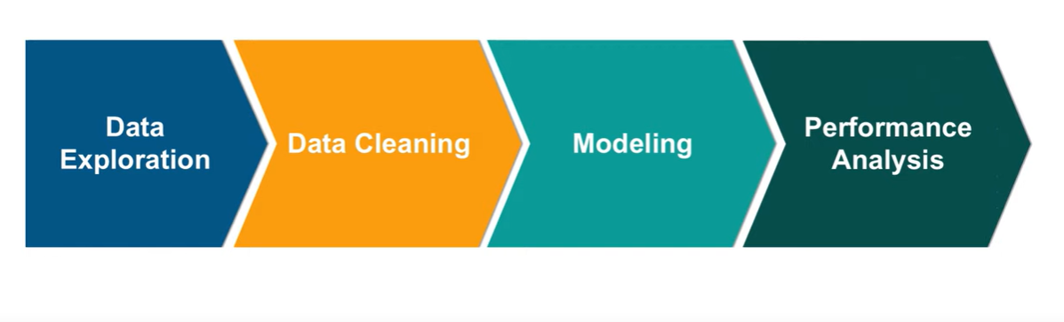
Steps Involved in Predictive Analysis

Slide 9
Steps
Data Exploration: It is basically understanding the data
Data Cleaning: It is used to get rid of redundancies in the data
Data Modeling: Model Selection and building accounts for a very important part in predictive analysis
Performance Analysis: After building the model, the analysis of the model is necessary for efficiency.

Slide 10
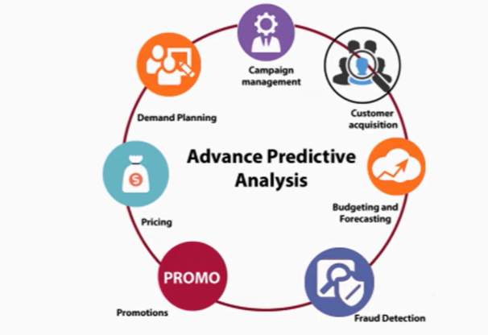
Applications of Predictive analytics
Predictive analysis can help in future projection that help in numerous businesses, etc.

Slide 11
Python packages
Numpy - performing scientific computations & to work with N-dimensional arrays
Pandas - It contains DataFrame as its main data structure. With DataFrame you can store and manage data from tables by performing manipulation over rows and columns.
Scikit-learn - It is being used for classification, regression and clustering or manage spam, image recognition, drug response, stock pricing, customer segmentation etc. It also allows dimensionality reduction, model selection and pre-processing.
Matplotlib - With Matplotlib, you can make histograms, plots, bar charts, scatter plots etc.
Seaborn - Seaborn was designed to visualize the complex statistical models. It has the potential to deliver accurate graphs such as heat maps. Seaborn was created on the concept of Matplotlib and somehow it is highly dependent on that.

Slide 12
R Packages
Dplyr - For performing data wrangling and data analysis
Ggplot2 - visualization (Plots and graphs) package
Caret - sing this function, you can model complex regression and classification problems. One important extension of the caret is CaretEnsemble which is used for combining different models.

Slide 13
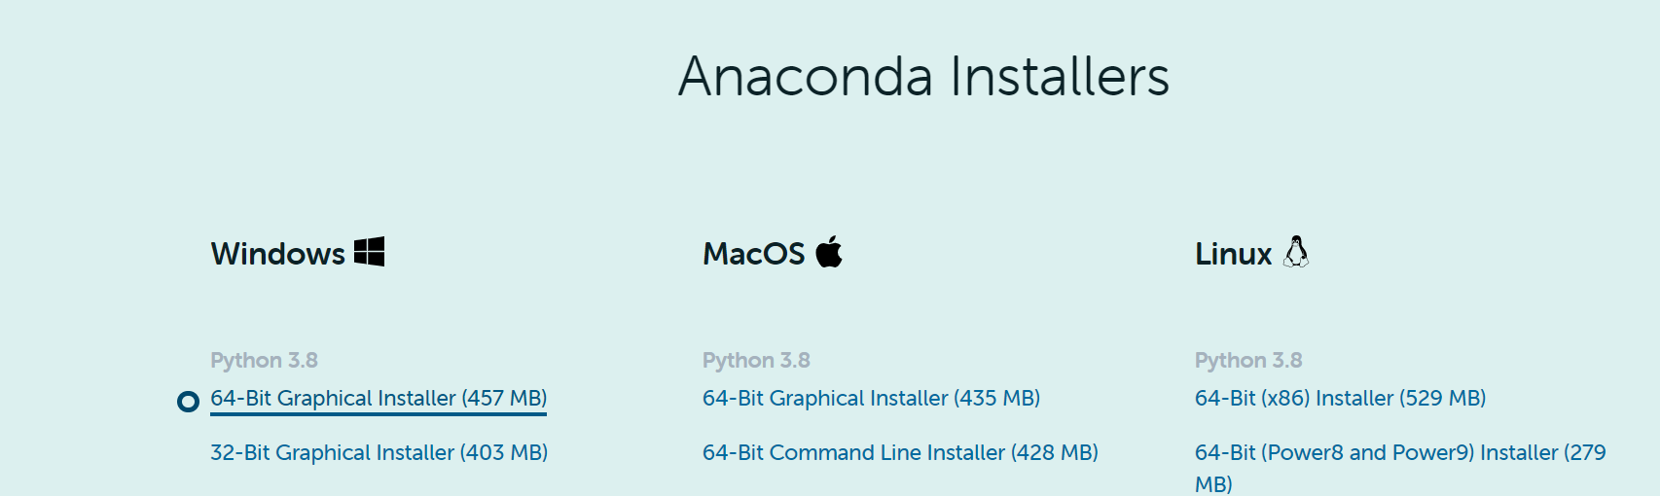
Anaconda Navigator
https://www.anaconda.com/products/individual

Slide 14
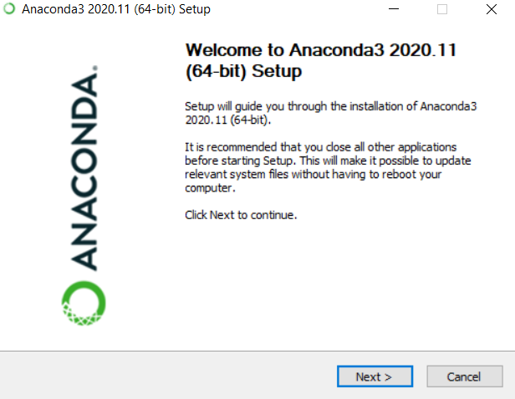

Slide 15
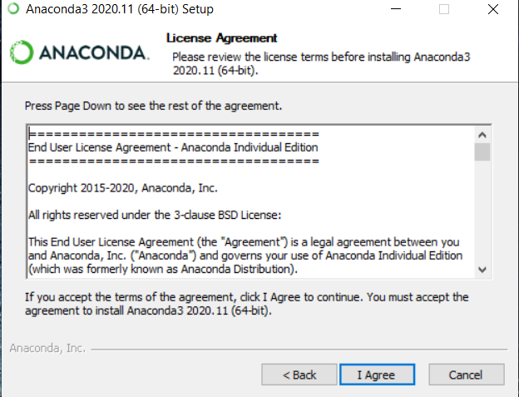

Slide 16


Slide 17
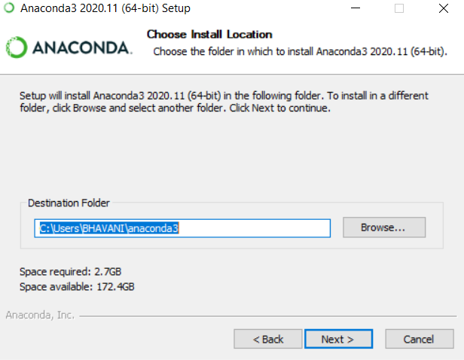

Slide 18
Basics – Variables, Measurement and Data
Variables : is a characteristic of any entity being studied that is capable of taking on different values.
Eg: a = 10
A is variable and 10 is vaue(measurement) and a=10 is data

Slide 19
How data add value to business?
Data warehouse
Development of data product
Algorithm solutions in production, marketing and sales (Recommendation engines)
Discovery of data Insight
Quantitative data analysis to help steer strategic business decision
Business value

Slide 20
Data Products
Automatic car
Google Map
Combo offer

